Slide 1
Analysis Of Tumor (Head & Neck) Presentation by: Sai Sasank Kothuru Sai Krishna Battula

Slide 2
Project analysis slide 2
Table of Contents
INTRODUCTION
SIDE EFFECTS
OBJECTIVES
PEOPLE WITH TUMOR
Analysis of Tumor
CLASSIFICATION
AJCC STAGES
SURVIVAL RATES FOR TUMOR
TUMORS AND AGES

Slide 3
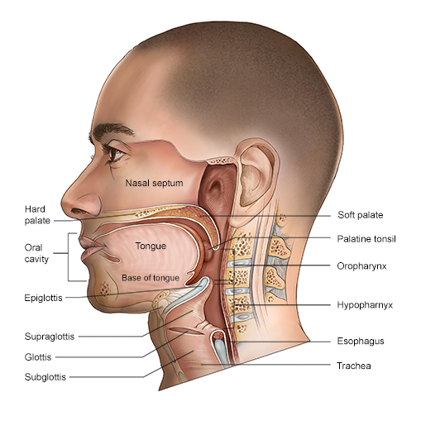
INTRODUCTION
We consider the data set of tumors as our main element. A tumor is nothing but a swelling of a part of the body, generally without inflammation, caused by an abnormal growth of tissue. Head and neck cancer is the 7th most common cancer globally accounting for more than 660,000 new cases and 325, 000 deaths annually. 4% of all cancers in the United States there appears to be an increasing incidence of this disease with potential changes in etiology proposed given the decline of smoking, particularly in developed countries.

Slide 4
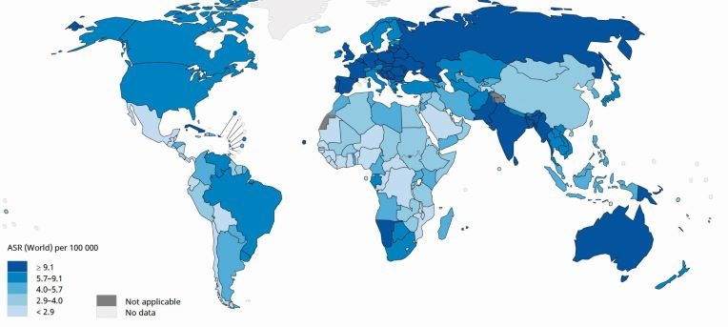
The tumor locations mainly are the oropharynx and larynx. It is estimated that 15,050 deaths (10,940 men and 4,110 women) from head and neck cancer will occur in the United States. In 2020, an estimated 277, 597 people worldwide died from this disease

Slide 5
CLASSIFICATION
There are many kinds of tumors, but here we will consider only the head and neck as the main parts of our data set.
There are mainly diversed into namely benign and malignant
Benign is considered a non-cancer. It might grow large but doesn't form in the nearby tissues.
Malignant is considered as cancer. It does not grow but spreads to all the nearby tissues

Slide 6
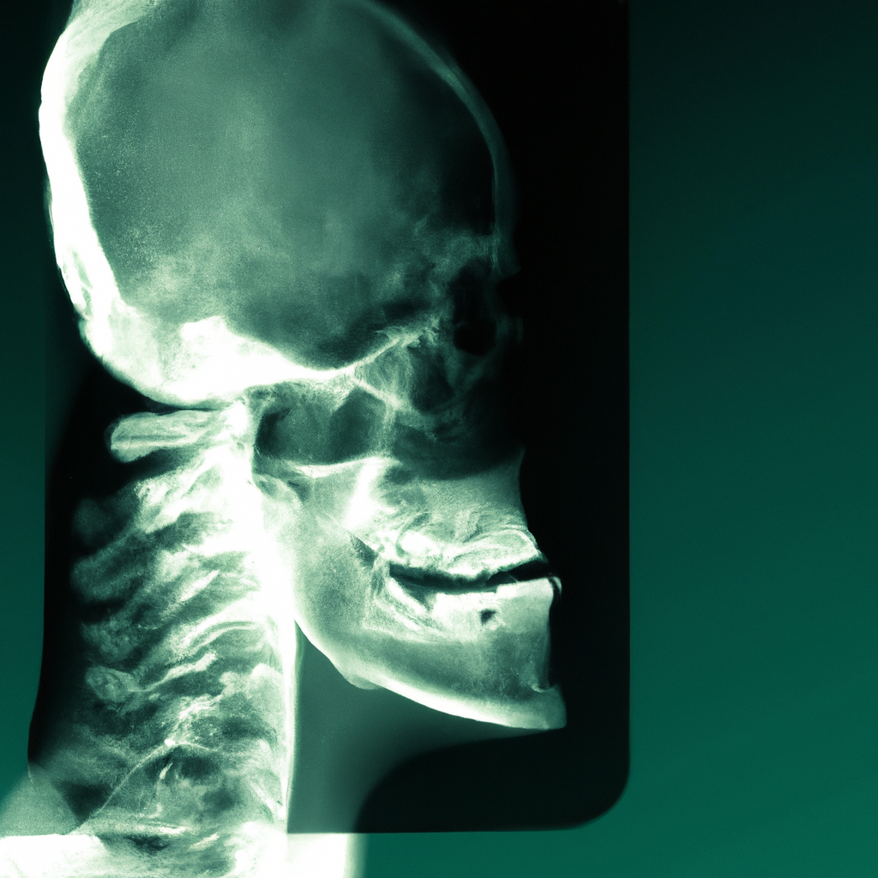
Diagnosis of Head and Neck Tumors
Diagnosing head and neck tumors typically involves a physical exam, imaging tests such as CT scans and MRIs, and a biopsy to confirm the presence of cancer cells.
In some cases, additional tests such as PET scans or blood tests may be necessary to determine the extent of cancer and whether it has spread to other parts of the body.
Mainly tumors occurs in Larynx and Oropharynx

Slide 7
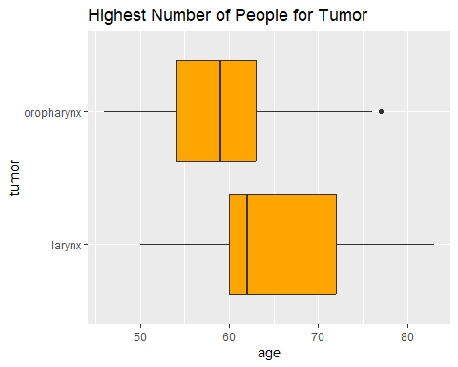
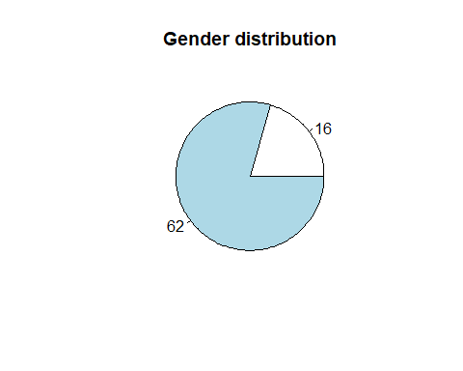
According to the data the Tumors are mostly occurs in Oropharynx
Males are more affecting to this tumors

Slide 8
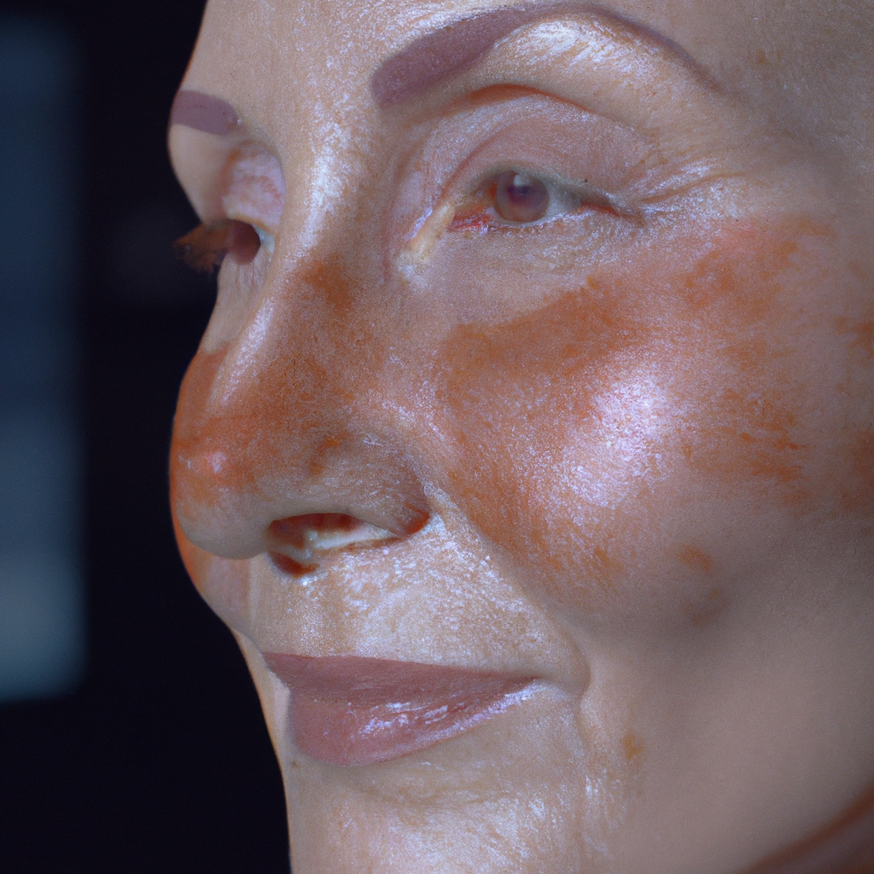
Side Effects of Treatment
While treatment for head and neck tumors can be effective, it often comes with side effects such as fatigue, nausea, and hair loss. Patients may also experience difficulty swallowing, speaking, or breathing, depending on the location and extent of the tumor.
It is essential for patients to work closely with their healthcare team to manage side effects and maintain their quality of life during treatment.

Slide 9
Stages
While staging head and neck cancer, the pathologist determines where exactly the disease formed, how extensive it is, and whether and how much it has spread. The stage of head and neck cancer is one of the most important factors in determining treatment options that may be tailored to your needs.
Head and neck cancer stages are typically based on the results of physical exams, biopsies, and imaging tests, such as CT scans, MRIs, chest X-rays, and/or PET scans.
The American Joint Committee on Cancer developed the TNM cancer staging system to evaluate three primary factors when it comes to treating cancer:

Slide 10

AJCC staging system
A system to describe the amount and spread of cancer in a patient’s body, using TNM. T describes the size of the tumor and any spread of cancer into nearby tissue; N describes spread of cancer to nearby lymph nodes; and M describes metastasis (spread of cancer to other parts of the body). This system was created and is updated by the American Joint Committee on Cancer (AJCC) and the International Union Against Cancer (UICC). The AJCC staging system is used to describe most types of cancer. Also called TNM staging system.

Slide 11
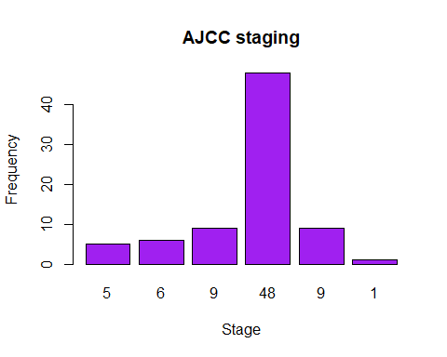
From the following graph we can
Observe that the ajcc staging is
Maximum for (iva) of 48 and min
For (ivc) of 1

Slide 12

Tumors and ages
According to the most recent statistical data from NCI’s Surveillance, the median age of a cancer diagnosis is 66 years. This means that half of cancer cases occur in people below this age and half in people above this age. A similar pattern is seen for many common cancer types. For example, the median age at diagnosis is 62 years for breast cancer, 67 years for colorectal cancer, 71 years for lung cancer, and 66 years for prostate cancer.
But cancer can be diagnosed at any age. For example, bone cancer is most frequently diagnosed in children and adolescents (people under age 20), with about one-fourth of cases occurring in this age group. And 12% of brain and other nervous system cancers are diagnosed in children and adolescents, whereas only 1% of cancer overall is diagnosed in this age group.

Slide 13
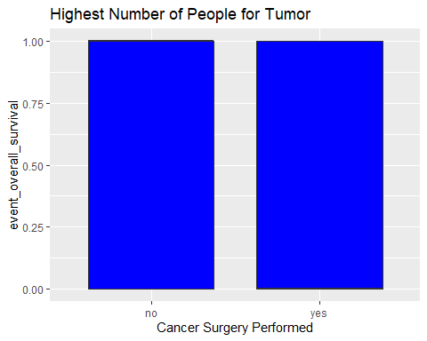
Cancer sugery has high recovery rate than the chemotherapy based on the analysis done by the given data

Slide 14

Survival rate
The survival rate for people with Stage I or Stage II cancer ranges from 70% to 90%. These numbers mean that 70% to 90% of people diagnosed with a head and neck cancer at these stages are alive after five years.

Slide 15
Design Overview
We used different types of functions, libraries and visualization methods for our tumors in Head&Neck data sets.
For Data wrangling we used dplyr() . plyr() for split-apply-combine the data
And for Data visualization ggplot2.

Slide 16
Thank You

